Slide 1


MACHINE LEARNING
UNIT 5

Slide 2

TOPICS TO BE COVERED…
Trends In Machine Learning: Model and Symbols- Bagging and Boosting, Ensemble Learning, Online learning and Sequence Prediction, Deep Learning, Reinforcement Learning.
Recommendation Systems: Content Based Recommendation System & Collaborative Filtering

Slide 3
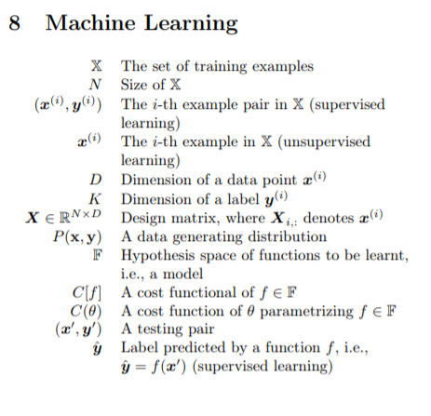
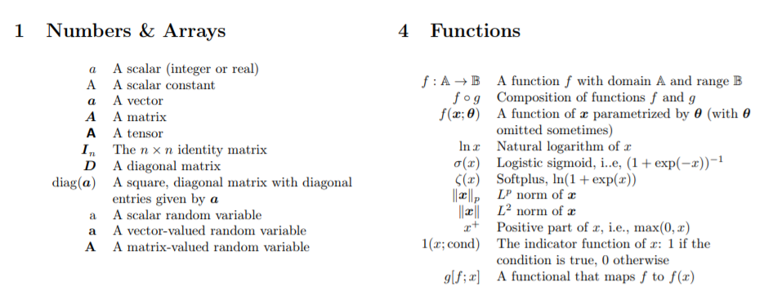
MODEL AND SYMBOLS

Slide 4
BAGGING AND BOOSTING
BAGGING AND BOOSTING ARE BOTH ENSEMBLE LEARNING METHODS IN MACHINE LEARNING.
BAGGING AND BOOSTING ARE SIMILAR IN THAT THEY ARE BOTH ENSEMBLE TECHNIQUES, WHERE A SET OF WEAK LEARNERS ARE COMBINED TO CREATE A STRONG LEARNER THAT OBTAINS BETTER PERFORMANCE THAN A SINGLE ONE.
ENSEMBLE LEARNING HELPS TO IMPROVE MACHINE LEARNING MODEL PERFORMANCE BY COMBINING SEVERAL MODELS. THIS APPROACH ALLOWS THE PRODUCTION OF BETTER PREDICTIVE PERFORMANCE COMPARED TO A SINGLE MODEL.
THE BASIC IDEA BEHIND ENSEMBLE LEARNING IS TO LEARN A SET OF CLASSIFIERS (EXPERTS) AND TO ALLOW THEM TO VOTE.
THIS DIVERSIFICATION IN MACHINE LEARNING IS ACHIEVED BY A TECHNIQUE CALLED ENSEMBLE LEARNING.
THE IDEA HERE IS TO TRAIN MULTIPLE MODELS, EACH WITH THE OBJECTIVE TO PREDICT OR CLASSIFY A SET OF RESULTS.
BAGGING AND BOOSTING ARE TWO TYPES OF ENSEMBLE LEARNING TECHNIQUES. THESE TWO DECREASE THE VARIANCE OF SINGLE ESTIMATE AS THEY COMBINE SEVERAL ESTIMATES FROM DIFFERENT MODELS.
SO THE RESULT MAY BE A MODEL WITH HIGHER STABILITY.
THE MAIN CAUSES OF ERROR IN LEARNING ARE DUE TO NOISE, BIAS AND VARIANCE.
ENSEMBLE HELPS TO MINIMIZE THESE FACTORS. BY USING ENSEMBLE METHODS, WE’RE ABLE TO INCREASE THE STABILITY OF THE FINAL MODEL AND REDUCE THE ERRORS MENTIONED PREVIOUSLY.

Slide 5
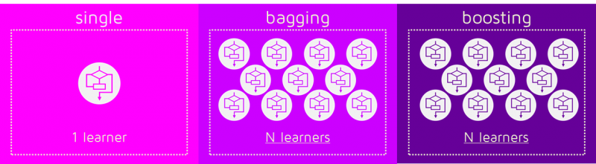
BAGGING HELPS TO DECREASE THE MODEL’S VARIANCE.
BOOSTING HELPS TO DECREASE THE MODEL’S BIAS.
THESE METHODS ARE DESIGNED TO IMPROVE THE STABILITY AND THE ACCURACY OF MACHINE LEARNING ALGORITHMS.
COMBINATIONS OF MULTIPLE CLASSIFIERS DECREASE VARIANCE, ESPECIALLY IN THE CASE OF UNSTABLE CLASSIFIERS, AND MAY PRODUCE A MORE RELIABLE CLASSIFICATION THAN A SINGLE CLASSIFIER.
TO USE BAGGING OR BOOSTING YOU MUST SELECT A BASE LEARNER ALGORITHM.
FOR EXAMPLE, IF WE CHOOSE A CLASSIFICATION TREE, BAGGING AND BOOSTING WOULD CONSIST OF A POOL OF TREES AS BIG AS WE WANT AS SHOWN IN THE FOLLOWING DIAGRAM:

Slide 6
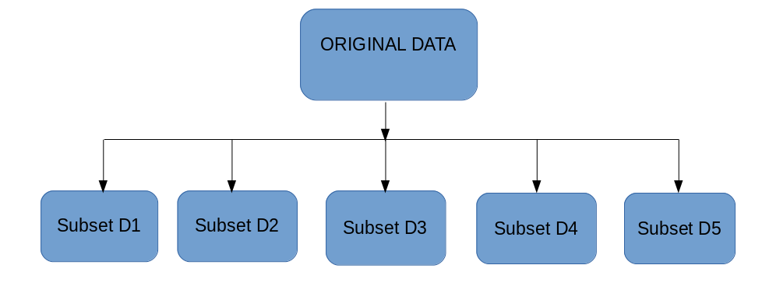
BAGGING
BAGGING ( OR BOOTSTRAP AGGREGATION), IS A SIMPLE AND VERY POWERFUL ENSEMBLE METHOD. BAGGING IS THE APPLICATION OF THE BOOTSTRAP PROCEDURE TO A HIGH-VARIANCE MACHINE LEARNING ALGORITHM, TYPICALLY DECISION TREES.
THE IDEA BEHIND BAGGING IS COMBINING THE RESULTS OF MULTIPLE MODELS (FOR INSTANCE, ALL DECISION TREES) TO GET A GENERALIZED RESULT. NOW, BOOTSTRAPPING COMES INTO PICTURE.
BAGGING (OR BOOTSTRAP AGGREGATING) TECHNIQUE USES THESE SUBSETS (BAGS) TO GET A FAIR IDEA OF THE DISTRIBUTION (COMPLETE SET). THE SIZE OF SUBSETS CREATED FOR BAGGING MAY BE LESS THAN THE ORIGINAL SET.
IT CAN BE REPRESENTED AS FOLLOWS:

Slide 7
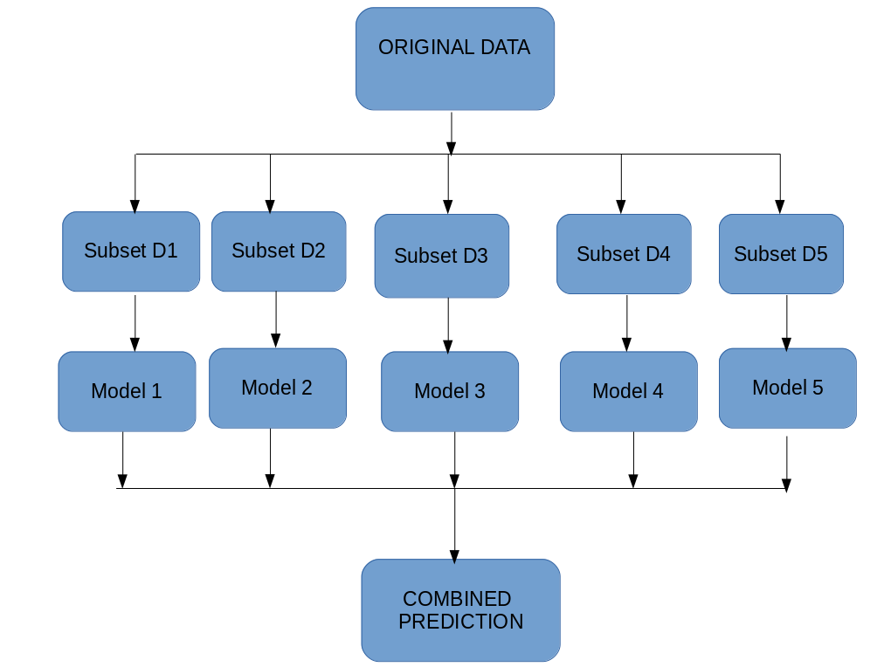
BAGGING WORKS AS FOLLOWS:-
MULTIPLE SUBSETS ARE CREATED FROM THE ORIGINAL DATASET, SELECTING OBSERVATIONS WITH REPLACEMENT.
A BASE MODEL (WEAK MODEL) IS CREATED ON EACH OF THESE SUBSETS.
THE MODELS RUN IN PARALLEL AND ARE INDEPENDENT OF EACH OTHER.
THE FINAL PREDICTIONS ARE DETERMINED BY COMBINING THE PREDICTIONS FROM ALL THE MODELS.
NOW, BAGGING CAN BE REPRESENTED DIAGRAMMATICALLY AS FOLLOWS:

Slide 8
BOOSTING
BOOSTING IS A SEQUENTIAL PROCESS, WHERE EACH SUBSEQUENT MODEL ATTEMPTS TO CORRECT THE ERRORS OF THE PREVIOUS MODEL. THE SUCCEEDING MODELS ARE DEPENDENT ON THE PREVIOUS MODEL.
IN THIS TECHNIQUE, LEARNERS ARE LEARNED SEQUENTIALLY WITH EARLY LEARNERS FITTING SIMPLE MODELS TO THE DATA AND THEN ANALYZING DATA FOR ERRORS. IN OTHER WORDS, WE FIT CONSECUTIVE TREES (RANDOM SAMPLE) AND AT EVERY STEP, THE GOAL IS TO SOLVE FOR NET ERROR FROM THE PRIOR TREE.
WHEN AN INPUT IS MISCLASSIFIED BY A HYPOTHESIS, ITS WEIGHT IS INCREASED SO THAT NEXT HYPOTHESIS IS MORE LIKELY TO CLASSIFY IT CORRECTLY. BY COMBINING THE WHOLE SET AT THE END CONVERTS WEAK LEARNERS INTO BETTER PERFORMING MODEL.

Slide 9
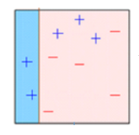
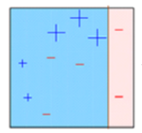
LET’S UNDERSTAND THE WAY BOOSTING WORKS IN THE BELOW STEPS.
A SUBSET IS CREATED FROM THE ORIGINAL DATASET.
INITIALLY, ALL DATA POINTS ARE GIVEN EQUAL WEIGHTS.
A BASE MODEL IS CREATED ON THIS SUBSET.
THIS MODEL IS USED TO MAKE PREDICTIONS ON THE WHOLE DATASET.
ERRORS ARE CALCULATED USING THE ACTUAL VALUES AND PREDICTED VALUES.
THE OBSERVATIONS WHICH ARE INCORRECTLY PREDICTED, ARE GIVEN HIGHER WEIGHTS. (HERE, THE THREE MISCLASSIFIED BLUE-PLUS POINTS WILL BE GIVEN HIGHER WEIGHTS)
ANOTHER MODEL IS CREATED AND PREDICTIONS ARE MADE ON THE DATASET. (THIS MODEL TRIES TO CORRECT THE ERRORS FROM THE PREVIOUS MODEL)

Slide 10
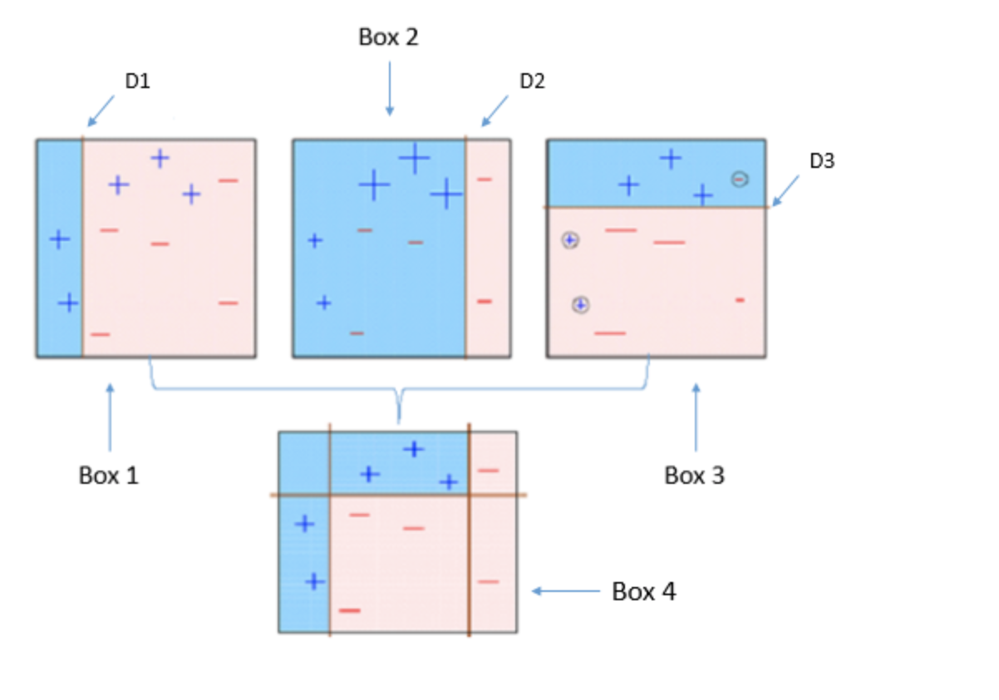
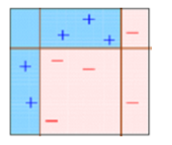
SIMILARLY, MULTIPLE MODELS ARE CREATED, EACH CORRECTING THE ERRORS OF THE PREVIOUS MODEL.
THE FINAL MODEL (STRONG LEARNER) IS THE WEIGHTED MEAN OF ALL THE MODELS (WEAK LEARNERS).
THUS, THE BOOSTING ALGORITHM COMBINES A NUMBER OF WEAK LEARNERS TO FORM A STRONG LEARNER.
THE INDIVIDUAL MODELS WOULD NOT PERFORM WELL ON THE ENTIRE DATASET, BUT THEY WORK WELL FOR SOME PART OF THE DATASET.
THUS, EACH MODEL ACTUALLY BOOSTS THE PERFORMANCE OF THE ENSEMBLE.

Slide 11
ENSEMBLE LEARNING
LET’S UNDERSTAND THE CONCEPT OF ENSEMBLE LEARNING WITH AN EXAMPLE.
SUPPOSE YOU ARE A MOVIE DIRECTOR AND YOU HAVE CREATED A SHORT MOVIE ON A VERY IMPORTANT AND INTERESTING TOPIC.
NOW, YOU WANT TO TAKE PRELIMINARY FEEDBACK (RATINGS) ON THE MOVIE BEFORE MAKING IT PUBLIC.
WHAT ARE THE POSSIBLE WAYS BY WHICH YOU CAN DO THAT?
A: YOU MAY ASK ONE OF YOUR FRIENDS TO RATE THE MOVIE FOR YOU. NOW IT’S ENTIRELY POSSIBLE THAT THE PERSON YOU HAVE CHOSEN LOVES YOU VERY MUCH AND DOESN’T WANT TO BREAK YOUR HEART BY PROVIDING A 1-STAR RATING TO THE HORRIBLE WORK YOU HAVE CREATED.
B: ANOTHER WAY COULD BE BY ASKING 5 COLLEAGUES OF YOURS TO RATE THE MOVIE. THIS SHOULD PROVIDE A BETTER IDEA OF THE MOVIE. THIS METHOD MAY PROVIDE HONEST RATINGS FOR YOUR MOVIE. BUT A PROBLEM STILL EXISTS. THESE 5 PEOPLE MAY NOT BE “SUBJECT MATTER EXPERTS” ON THE TOPIC OF YOUR MOVIE. SURE, THEY MIGHT UNDERSTAND THE CINEMATOGRAPHY, THE SHOTS, OR THE AUDIO, BUT AT THE SAME TIME MAY NOT BE THE BEST JUDGES OF DARK HUMOUR.

Slide 12
C: HOW ABOUT ASKING 50 PEOPLE TO RATE THE MOVIE? SOME OF WHICH CAN BE YOUR FRIENDS, SOME OF THEM CAN BE YOUR COLLEAGUES AND SOME MAY EVEN BE TOTAL STRANGERS.
THE RESPONSES, IN THIS CASE, WOULD BE MORE GENERALIZED AND DIVERSIFIED SINCE NOW YOU HAVE PEOPLE WITH DIFFERENT SETS OF SKILLS.
WITH THESE EXAMPLES, YOU CAN INFER THAT A DIVERSE GROUP OF PEOPLE ARE LIKELY TO MAKE BETTER DECISIONS AS COMPARED TO INDIVIDUALS.
SIMILAR IS TRUE FOR A DIVERSE SET OF MODELS IN COMPARISON TO SINGLE MODELS.
THIS DIVERSIFICATION IN MACHINE LEARNING IS ACHIEVED BY A TECHNIQUE CALLED ENSEMBLE LEARNING.

Slide 13
SIMPLE ENSEMBLE TECHNIQUES:
IN THIS SECTION, WE WILL LOOK AT A FEW SIMPLE BUT POWERFUL TECHNIQUES, NAMELY:
MAX VOTING.
AVERAGING.
WEIGHTED AVERAGING.
MAX VOTING:
THE MAX VOTING METHOD IS GENERALLY USED FOR CLASSIFICATION PROBLEMS.
IN THIS TECHNIQUE, MULTIPLE MODELS ARE USED TO MAKE PREDICTIONS FOR EACH DATA POINT.
THE PREDICTIONS BY EACH MODEL ARE CONSIDERED AS A ‘VOTE’.
THE PREDICTIONS WHICH WE GET FROM THE MAJORITY OF THE MODELS ARE USED AS THE FINAL PREDICTION.

Slide 14
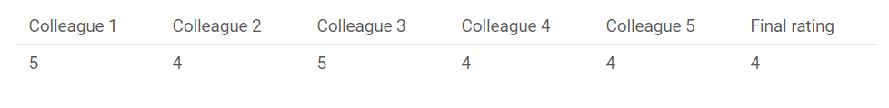
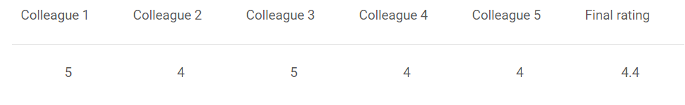
FOR EXAMPLE, WHEN YOU ASKED 5 OF YOUR COLLEAGUES TO RATE YOUR MOVIE (OUT OF 5); WE’LL ASSUME THREE OF THEM RATED IT AS 4 WHILE TWO OF THEM GAVE IT A 5. SINCE THE MAJORITY GAVE A RATING OF 4, THE FINAL RATING WILL BE TAKEN AS 4. YOU CAN CONSIDER THIS AS TAKING THE MODE OF ALL THE PREDICTIONS.
THE RESULT OF MAX VOTING WOULD BE SOMETHING LIKE THIS:
AVERAGING
SIMILAR TO THE MAX VOTING TECHNIQUE, MULTIPLE PREDICTIONS ARE MADE FOR EACH DATA POINT IN AVERAGING. IN THIS METHOD, WE TAKE AN AVERAGE OF PREDICTIONS FROM ALL THE MODELS AND USE IT TO MAKE THE FINAL PREDICTION. AVERAGING CAN BE USED FOR MAKING PREDICTIONS IN REGRESSION PROBLEMS OR WHILE CALCULATING PROBABILITIES FOR CLASSIFICATION PROBLEMS.
FOR EXAMPLE, IN THE BELOW CASE, THE AVERAGING METHOD WOULD TAKE THE AVERAGE OF ALL THE VALUES.
I.E. (5+4+5+4+4)/5 = 4.4

Slide 15
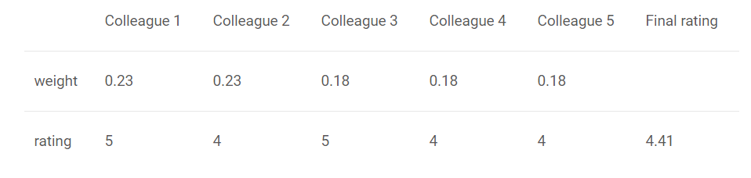
WEIGHTED AVERAGE:
THIS IS AN EXTENSION OF THE AVERAGING METHOD. ALL MODELS ARE ASSIGNED DIFFERENT WEIGHTS DEFINING THE IMPORTANCE OF EACH MODEL FOR PREDICTION. FOR INSTANCE, IF TWO OF YOUR COLLEAGUES ARE CRITICS, WHILE OTHERS HAVE NO PRIOR EXPERIENCE IN THIS FIELD, THEN THE ANSWERS BY THESE TWO FRIENDS ARE GIVEN MORE IMPORTANCE AS COMPARED TO THE OTHER PEOPLE.
THE RESULT IS CALCULATED AS :
[(5*0.23) + (4*0.23) + (5*0.18) + (4*0.18) + (4*0.18)] = 4.41.

Slide 16
ADVANCED ENSEMBLE TECHNIQUES
NOW THAT WE HAVE COVERED THE BASIC ENSEMBLE TECHNIQUES, LET’S MOVE ON TO UNDERSTANDING THE ADVANCED TECHNIQUES.
STACKING.
BLENDING.
BAGGING.
BOOSTING.

Slide 17
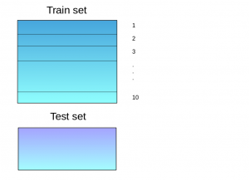
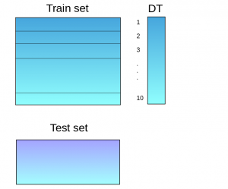
STACKING
STACKING IS AN ENSEMBLE LEARNING TECHNIQUE THAT USES PREDICTIONS FROM MULTIPLE MODELS (FOR EXAMPLE DECISION TREE, KNN OR SVM) TO BUILD A NEW MODEL.
THIS MODEL IS USED FOR MAKING PREDICTIONS ON THE TEST SET. BELOW IS A STEP-WISE EXPLANATION FOR A SIMPLE STACKED ENSEMBLE:
1 THE TRAIN SET IS SPLIT INTO 10 PARTS:
2 A BASE MODEL (SUPPOSE A DECISION TREE) IS FITTED ON 9 PARTS AND PREDICTIONS ARE MADE FOR THE 10TH PART. THIS IS DONE FOR EACH PART OF THE TRAIN SET.

Slide 18
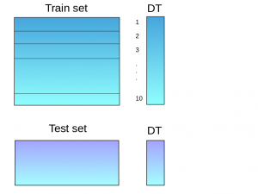
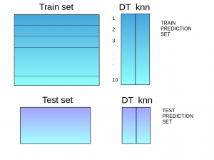
3. THE BASE MODEL (IN THIS CASE, DECISION TREE) IS THEN FITTED ON THE WHOLE TRAIN DATASET.
4. USING THIS MODEL, PREDICTIONS ARE MADE ON THE TEST SET
5. STEPS 2 TO 4 ARE REPEATED FOR ANOTHER BASE MODEL (SAY KNN) RESULTING IN ANOTHER SET OF PREDICTIONS FOR THE TRAIN SET AND TEST SET.

Slide 19
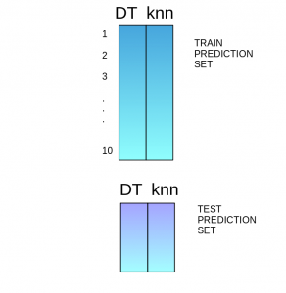
6. THE PREDICTIONS FROM THE TRAIN SET ARE USED AS FEATURES TO BUILD A NEW MODEL.
7. THIS MODEL IS USED TO MAKE FINAL PREDICTIONS ON THE TEST PREDICTION SET.

Slide 20
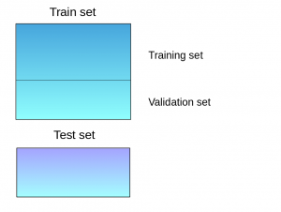
BLENDING:
BLENDING FOLLOWS THE SAME APPROACH AS STACKING BUT USES ONLY A HOLDOUT (VALIDATION) SET FROM THE TRAIN SET TO MAKE PREDICTIONS.
IN OTHER WORDS, UNLIKE STACKING, THE PREDICTIONS ARE MADE ON THE HOLDOUT SET ONLY. THE HOLDOUT SET AND THE PREDICTIONS ARE USED TO BUILD A MODEL WHICH IS RUN ON THE TEST SET. HERE IS A DETAILED EXPLANATION OF THE BLENDING PROCESS:
1. THE TRAIN SET IS SPLIT INTO TRAINING AND VALIDATION SETS.

Slide 21
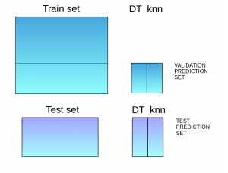
2. MODEL(S) ARE FITTED ON THE TRAINING SET.
3. THE PREDICTIONS ARE MADE ON THE VALIDATION SET AND THE TEST SET.
4. THE VALIDATION SET AND ITS PREDICTIONS ARE USED AS FEATURES TO BUILD A NEW MODEL.
5. THIS MODEL IS USED TO MAKE FINAL PREDICTIONS ON THE TEST AND META-FEATURES.

Slide 22
BAGGING & BOOSTING: COVERED AHEAD IN THE SLIDES
ALGORITHMS BASED ON BAGGING AND BOOSTING
BAGGING AND BOOSTING ARE TWO OF THE MOST COMMONLY USED TECHNIQUES IN MACHINE LEARNING. IN THIS SECTION, WE WILL LOOK AT THEM IN DETAIL. FOLLOWING ARE THE ALGORITHMS WE WILL BE FOCUSING ON:
BAGGING ALGORITHMS:
BAGGING META-ESTIMATOR
RANDOM FOREST
BOOSTING ALGORITHMS:
ADABOOST
GBM
XGBM
LIGHT GBM
CATBOOST

Slide 23
ONLINE LEARNING AND SEQUENCE PREDICTION
ONLINE MACHINE LEARNING IS A METHOD OF MACHINE LEARNING IN WHICH DATA BECOMES AVAILABLE IN A SEQUENTIAL ORDER AND IS USED TO UPDATE THE BEST PREDICTOR FOR FUTURE DATA AT EACH STEP, AS OPPOSED TO BATCH LEARNING TECHNIQUES WHICH GENERATE THE BEST PREDICTOR BY LEARNING ON THE ENTIRE TRAINING DATA SET AT ONCE.
ONLINE LEARNING IS A COMMON TECHNIQUE USED IN AREAS OF MACHINE LEARNING WHERE IT IS COMPUTATIONALLY INFEASIBLE TO TRAIN OVER THE ENTIRE DATASET, REQUIRING THE NEED OF OUT-OF-CORE ALGORITHMS.
IT IS ALSO USED IN SITUATIONS WHERE IT IS NECESSARY FOR THE ALGORITHM TO DYNAMICALLY ADAPT TO NEW PATTERNS IN THE DATA, OR WHEN THE DATA ITSELF IS GENERATED AS A FUNCTION OF TIME, E.G., STOCK PRICE PREDICTION

Slide 24
SEQUENCE PREDICTION IS A POPULAR MACHINE LEARNING TASK, WHICH CONSISTS OF PREDICTING THE NEXT SYMBOL(S) BASED ON THE PREVIOUSLY OBSERVED SEQUENCE OF SYMBOLS. THESE SYMBOLS COULD BE A NUMBER, AN ALPHABET, A WORD, AN EVENT, OR AN OBJECT LIKE A WEBPAGE OR PRODUCT. FOR EXAMPLE:
A SEQUENCE OF WORDS OR CHARACTERS IN A TEXT.
A SEQUENCE OF PRODUCTS BOUGHT BY A CUSTOMER.
A SEQUENCE OF EVENTS OBSERVED ON LOGS.
SEQUENCE PREDICTION IS DIFFERENT FROM OTHER TYPES OF SUPERVISED LEARNING PROBLEMS, AS IT IMPOSES THAT THE ORDER IN THE DATA MUST BE PRESERVED WHEN TRAINING MODELS AND MAKING PREDICTIONS.
SEQUENCE PREDICTION IS A COMMON PROBLEM WHICH FINDS REAL-LIFE APPLICATIONS IN VARIOUS INDUSTRIES. WE WILL INTRODUCE YOU THREE TYPES OF SEQUENCE PREDICTION PROBLEMS:
PREDICTING THE NEXT VALUE.
PREDICTING A CLASS LABEL.
PREDICTING A SEQUENCE.

Slide 25
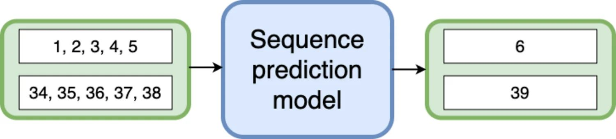
PREDICTING THE NEXT VALUE
BEING ABLE TO GUESS THE NEXT ELEMENT OF A SEQUENCE IS AN IMPORTANT QUESTION IN MANY APPLICATIONS.
A SEQUENCE PREDICTION MODEL LEARNS TO IDENTIFY THE PATTERN IN THE SEQUENTIAL INPUT DATA AND PREDICT THE NEXT VALUE.

Slide 26
DEEP LEARNING
DEEP LEARNING IS A MACHINE LEARNING TECHNIQUE THAT TEACHES COMPUTERS TO DO WHAT COMES NATURALLY TO HUMANS: LEARN BY EXAMPLE. DEEP LEARNING IS A KEY TECHNOLOGY BEHIND DRIVERLESS CARS, ENABLING THEM TO RECOGNIZE A STOP SIGN.
IT IS THE KEY TO VOICE CONTROL IN CONSUMER DEVICES LIKE PHONES, TABLETS, TVS, AND HANDS-FREE SPEAKERS.
DEEP LEARNING IS GETTING LOTS OF ATTENTION LATELY AND FOR GOOD REASON.
IT’S ACHIEVING RESULTS THAT WERE NOT POSSIBLE BEFORE.
IN DEEP LEARNING, A COMPUTER MODEL LEARNS TO PERFORM CLASSIFICATION TASKS DIRECTLY FROM IMAGES, TEXT, OR SOUND.
DEEP LEARNING MODELS CAN ACHIEVE STATE-OF-THE-ART ACCURACY, SOMETIMES EXCEEDING HUMAN-LEVEL PERFORMANCE.
MODELS ARE TRAINED BY USING A LARGE SET OF LABELED DATA AND NEURAL NETWORK ARCHITECTURES THAT CONTAIN MANY LAYERS.

Slide 27
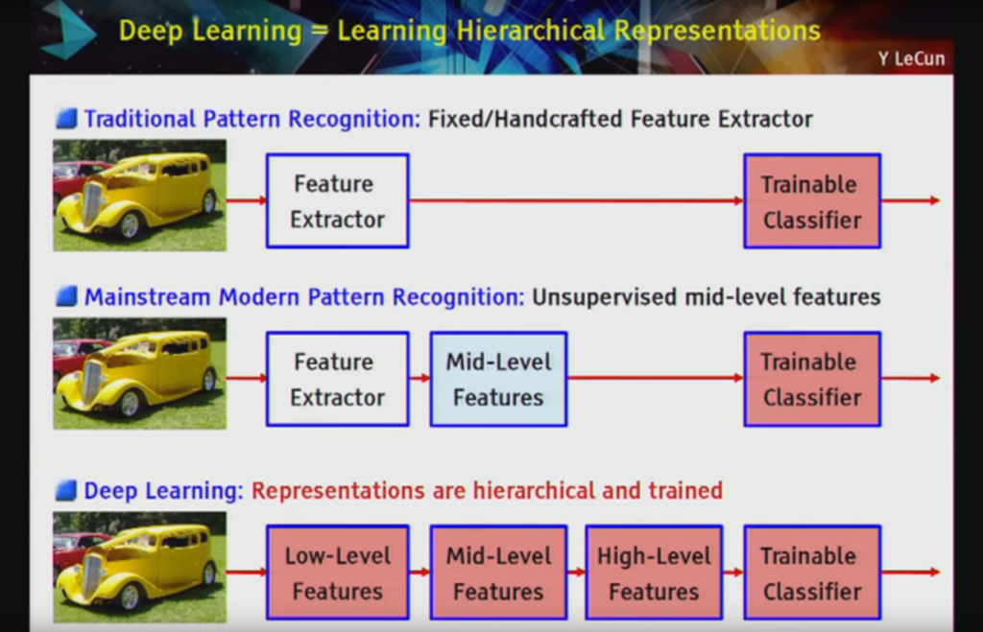

Slide 28
MOST DEEP LEARNING METHODS USE NEURAL NETWORK ARCHITECTURES, WHICH IS WHY DEEP LEARNING MODELS ARE OFTEN REFERRED TO AS DEEP NEURAL NETWORKS.
THE TERM “DEEP” USUALLY REFERS TO THE NUMBER OF HIDDEN LAYERS IN THE NEURAL NETWORK. TRADITIONAL NEURAL NETWORKS ONLY CONTAIN 2-3 HIDDEN LAYERS, WHILE DEEP NETWORKS CAN HAVE AS MANY AS 150.
DEEP LEARNING MODELS ARE TRAINED BY USING LARGE SETS OF LABELED DATA AND NEURAL NETWORK ARCHITECTURES THAT LEARN FEATURES DIRECTLY FROM THE DATA WITHOUT THE NEED FOR MANUAL FEATURE EXTRACTION.

Slide 29
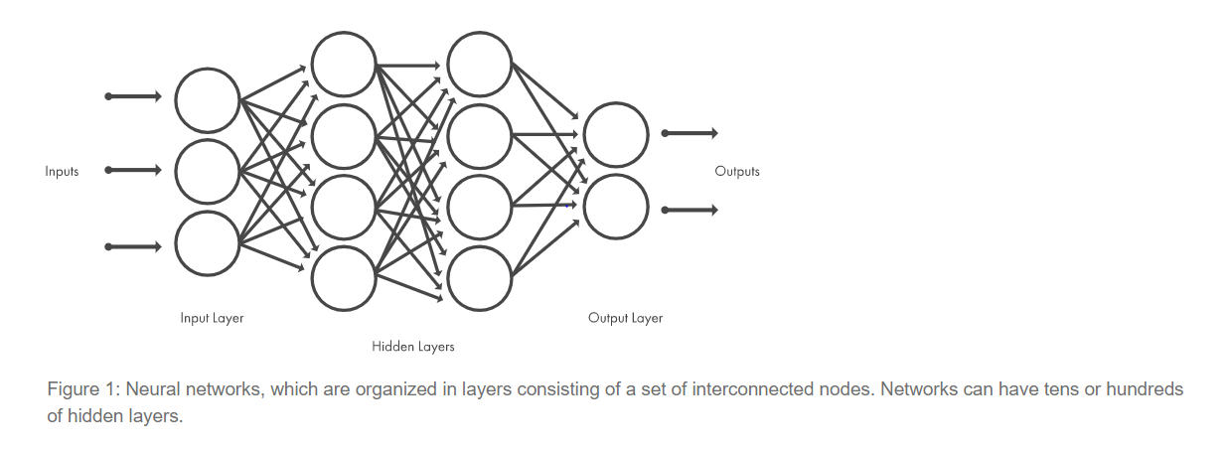

Slide 30
EXAMPLES OF DEEP LEARNING
AS WE KNOW DEEP LEARNING AND MACHINE LEARNING ARE SUBSETS OF ARTIFICIAL INTELLIGENCE BUT DEEP LEARNING TECHNOLOGY REPRESENTS THE NEXT EVOLUTION OF MACHINE LEARNING.
AS MACHINE LEARNING WILL WORK BASED ON ALGORITHMS AND PROGRAMS DEVELOPED BY HUMANS WHEREAS DEEP LEARNING LEARNS THROUGH A NEURAL NETWORK MODEL WHICH ACTS LIKE SIMILAR TO HUMANS AND ALLOWS MACHINE OR COMPUTER TO ANALYZE THE DATA IN A SIMILAR WAY AS HUMANS DO. THIS BECOMES POSSIBLE AS WE TRAIN THE NEURAL NETWORK MODELS WITH A HUGE AMOUNT OF DATA AS DATA IS THE FUEL OR FOOD FOR NEURAL NETWORK MODELS.
BELOW ARE SOME OF THE EXAMPLES IN THE REAL WORLD:
COMPUTER VISION: COMPUTER VISION DEALS WITH ALGORITHMS FOR COMPUTERS TO UNDERSTAND THE WORLD USING AN IMAGE AND VIDEO DATA AND TASKS SUCH AS IMAGE RECOGNITION, IMAGE CLASSIFICATION, OBJECT DETECTION, IMAGE SEGMENTATION, IMAGE RESTORATION ETC.

Slide 31
SPEECH AND NATURAL LANGUAGE PROCESSING: NATURAL LANGUAGE PROCESSING DEALS WITH ALGORITHMS FOR COMPUTERS TO UNDERSTAND, INTERPRET, AND MANIPULATE IN HUMAN LANGUAGE. NLP ALGORITHMS WORK WITH TEXT AND AUDIO DATA AND TRANSFORM THEM INTO AUDIO OR TEXT OUTPUT. USING NLP WE CAN DO TASKS SUCH AS SENTIMENT ANALYSIS, SPEECH RECOGNITION, LANGUAGE TRANSITION, AND NATURAL LANGUAGE GENERATION ETC.
AUTONOMOUS VEHICLES: DEEP LEARNING MODELS ARE TRAINED WITH A HUGE AMOUNT OF DATA FOR IDENTIFYING STREET SIGNS; SOME MODELS SPECIALIZE IN IDENTIFYING PEDESTRIANS, IDENTIFYING HUMANS ETC. FOR DRIVERLESS CARS WHILE DRIVING.
IMAGE FILTERING: BY USING DEEP LEARNING MODELS SUCH AS ADDING COLOR TO BLACK-AND-WHITE IMAGES CAN BE DONE BY DEEP LEARNING MODELS WHICH WILL TAKE MORE TIME IF WE DO MANUALLY.

Slide 32
APPLICATION OF DEEP LEARNING
APPLICATIONS OF DEEP LEARNING ARE VAST, BUT WE WOULD TRY TO COVER THE MOST USED APPLICATION OF DEEP LEARNING TECHNIQUES. HERE ARE SOME OF THE DEEP LEARNING APPLICATIONS, WHICH ARE NOW CHANGING THE WORLD AROUND US VERY RAPIDLY.
TOXICITY DETECTION FOR DIFFERENT CHEMICAL STRUCTURES
HERE DEEP LEARNING METHOD IS VERY EFFICIENT, WHERE EXPERTS USED TO TAKE DECADES OF TIME TO DETERMINE THE TOXICITY OF A SPECIFIC STRUCTURE, BUT WITH DEEP LEARNING MODEL IT IS POSSIBLE TO DETERMINE TOXICITY IN VERY LESS AMOUNT OF TIME (DEPENDS ON COMPLEXITY COULD BE HOURS OR DAYS).
MITOSIS DETECTION/ RADIOLOGY
DETERMINING CANCER DETECTION DEEP LEARNING MODEL HAS 6000 FACTORS WHICH COULD HELP IN PREDICTING THE SURVIVAL OF A PATIENT. FOR BREAST CANCER DIAGNOSIS DEEP LEARNING MODEL HAS BEEN PROVEN EFFICIENT AND EFFECTIVE. CNN MODEL OF DEEP LEARNING IS NOW ABLE TO DETECT AS WELL AS CLASSIFY MITOSIS INPATIENT. DEEP NEURAL NETWORKS HELP IN THE INVESTIGATION OF THE CELL LIFE CYCLE

Slide 33
TEXT EXTRACTION AND TEXT RECOGNITION
TEXT EXTRACTION ITSELF HAS A LOT OF APPLICATIONS IN THE REAL WORLD. FOR EXAMPLE, AUTOMATIC TRANSLATION FROM ONE LANGUAGE TO OTHER, SENTIMENTAL ANALYSIS OF DIFFERENT REVIEWS. THIS WIDELY IS KNOWN AS NATURAL LANGUAGE PROCESSING. WHEN WRITING AN EMAIL WE SEE AUTO-SUGGESTION TO COMPLETE THE SENTENCE IS ALSO THE APPLICATION OF DEEP LEARNING.
MARKET PREDICTION
DEEP LEARNING MODELS CAN PREDICT BUY AND SELL CALLS FOR TRADERS, DEPENDING ON THE DATASET HOW THE MODEL HAS BEEN TRAINED, IT IS USEFUL FOR BOTH SHORT TERM TRADING GAME AS WELL AS LONG TERM INVESTMENT BASED ON THE AVAILABLE FEATURES.
FRAUD DETECTION
A DEEP LEARNING MODEL USES MULTIPLE DATA SOURCES TO FLAG A DECISION AS A FRAUD IN REAL-TIME. WITH DEEP LEARNING MODELS, IT IS ALSO POSSIBLE TO FIND OUT WHICH PRODUCT AND WHICH MARKETS ARE MOST SUSCEPTIBLE TO FRAUD AND PROVIDE OR EXTRA CARE IN SUCH CASES.

Slide 34
REINFORCEMENT LEARNING
REINFORCEMENT IS THE FIELD OF MACHINE LEARNING THAT INVOLVES LEARNING WITHOUT THE INVOLVEMENT OF ANY HUMAN INTERACTION AS IT HAS AN AGENT THAT LEARNS HOW TO BEHAVE IN AN ENVIRONMENT BY PERFORMING ACTIONS AND THEN LEARN BASED UPON THE OUTCOME OF THESE ACTIONS TO OBTAIN THE REQUIRED GOAL THAT IS SET BY THE SYSTEM TWO ACCOMPLISH.
BASED UPON THE TYPE OF GOALS IT IS CLASSIFIED AS POSITIVE AND NEGATIVE LEARNING METHODS WITH THERE APPLICATION IN THE FIELD OF HEALTHCARE, EDUCATION, COMPUTER VISION, GAMES, NLP, TRANSPORTATION, ETC.

Slide 35
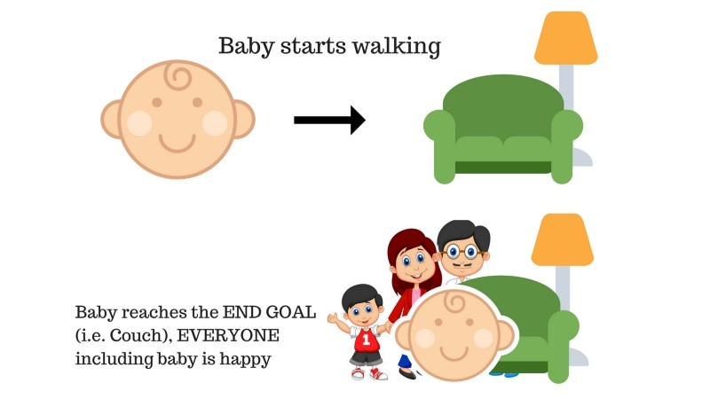
UNDERSTAND REINFORCEMENT LEARNING
LET US TRY TO UNDER THE WORKING OF REINFORCEMENT LEARNING WITH THE HELP OF 2 SIMPLE USE CASES:
CASE #1
THERE IS A BABY IN THE FAMILY AND SHE HAS JUST STARTED WALKING AND EVERYONE IS QUITE HAPPY ABOUT IT. ONE DAY, THE PARENTS TRY TO SET A GOAL, LET US BABY REACH THE COUCH, AND SEE IF THE BABY IS ABLE TO DO SO.
RESULT OF CASE 1: THE BABY SUCCESSFULLY REACHES THE SETTEE AND THUS EVERYONE IN THE FAMILY IS VERY HAPPY TO SEE THIS. THE CHOSEN PATH NOW COMES WITH A POSITIVE REWARD.
POINTS: REWARD + (+N) → POSITIVE REWARD.

Slide 36
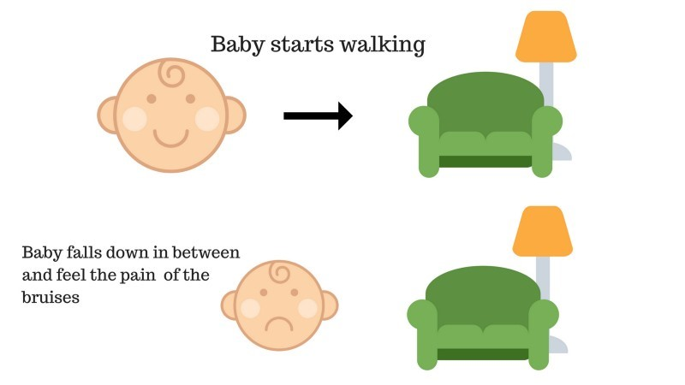
CASE #2
THE BABY WAS NOT ABLE TO REACH THE COUCH AND THE BABY HAS FALLEN.
IT HURTS! WHAT POSSIBLY COULD BE THE REASON?
THERE MIGHT BE SOME OBSTACLES IN THE PATH TO THE COUCH AND THE BABY HAD FALLEN TO OBSTACLES.
RESULT OF CASE 2: THE BABY FALLS TO SOME OBSTACLES AND SHE CRIES! OH, THAT WAS BAD, SHE LEARNED, NOT TO FALL IN THE TRAP OF OBSTACLE THE NEXT TIME. THE CHOSEN PATH NOW COMES WITH A NEGATIVE REWARD.
POINTS: REWARDS + (-N) →NEGATIVE REWARD.

Slide 37
TYPES OF REINFORCEMENT LEARNING
BELOW ARE THE TWO TYPES OF REINFORCEMENT LEARNING WITH THEIR ADVANTAGES AND DISADVANTAGES:
1. POSITIVE
WHEN THE STRENGTH AND FREQUENCY OF THE BEHAVIOR ARE INCREASED DUE TO THE OCCURRENCE OF SOME PARTICULAR BEHAVIOR, IT IS KNOWN AS POSITIVE REINFORCEMENT LEARNING.
ADVANTAGES: THE PERFORMANCE IS MAXIMIZED AND THE CHANGE REMAINS FOR A LONGER TIME.
DISADVANTAGES: RESULTS CAN BE DIMINISHED IF WE HAVE TOO MUCH REINFORCEMENT.
2. NEGATIVE
IT IS THE STRENGTHENING OF BEHAVIOR, MOSTLY BECAUSE OF THE NEGATIVE TERM VANISHES.
ADVANTAGES: BEHAVIOR IS INCREASED.
DISADVANTAGES: ONLY THE MINIMUM BEHAVIOR OF THE MODEL CAN BE REACHED WITH THE HELP OF NEGATIVE REINFORCEMENT LEARNING.

Slide 38
RECOMMENDATION SYSTEMS
RECOMMENDER SYSTEMS ARE THE SYSTEMS THAT ARE DESIGNED TO RECOMMEND THINGS TO THE USER BASED ON MANY DIFFERENT FACTORS.
THESE SYSTEMS PREDICT THE MOST LIKELY PRODUCT THAT THE USERS ARE MOST LIKELY TO PURCHASE AND ARE OF INTEREST TO.
COMPANIES LIKE NETFLIX, AMAZON, ETC. USE RECOMMENDER SYSTEMS TO HELP THEIR USERS TO IDENTIFY THE CORRECT PRODUCT OR MOVIES FOR THEM.
THE RECOMMENDER SYSTEM DEALS WITH A LARGE VOLUME OF INFORMATION PRESENT BY FILTERING THE MOST IMPORTANT INFORMATION BASED ON THE DATA PROVIDED BY A USER AND OTHER FACTORS THAT TAKE CARE OF THE USER’S PREFERENCE AND INTEREST.
IT FINDS OUT THE MATCH BETWEEN USER AND ITEM AND IMPUTES THE SIMILARITIES BETWEEN USERS AND ITEMS FOR RECOMMENDATION. BOTH THE USERS AND THE SERVICES PROVIDED HAVE BENEFITED FROM THESE KINDS OF SYSTEMS.
THE QUALITY AND DECISION-MAKING PROCESS HAS ALSO IMPROVED THROUGH THESE KINDS OF SYSTEMS.

Slide 39
WHY THE RECOMMENDATION SYSTEM?
BENEFITS USERS IN FINDING ITEMS OF THEIR INTEREST.
HELP ITEM PROVIDERS IN DELIVERING THEIR ITEMS TO THE RIGHT USER.
IDENTITY PRODUCTS THAT ARE MOST RELEVANT TO USERS.
PERSONALIZED CONTENT.- HELP WEBSITES TO IMPROVE USER ENGAGEMENT.
WHAT CAN BE RECOMMENDED?
THERE ARE MANY DIFFERENT THINGS THAT CAN BE RECOMMENDED BY THE SYSTEM LIKE MOVIES, BOOKS, NEWS, ARTICLES, JOBS, ADVERTISEMENTS, ETC.
NETFLIX USES A RECOMMENDER SYSTEM TO RECOMMEND MOVIES & WEB-SERIES TO ITS USERS. SIMILARLY, YOUTUBE RECOMMENDS DIFFERENT VIDEOS.
THERE ARE MANY EXAMPLES OF RECOMMENDER SYSTEMS THAT ARE WIDELY USED TODAY.

Slide 40
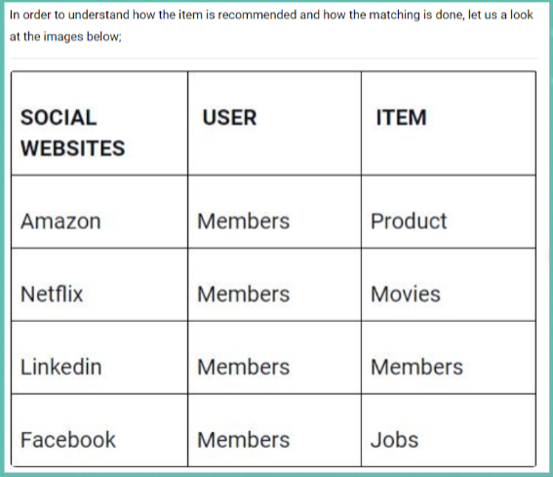
HOW DO USER AND ITEM MATCHING IS DONE..?

Slide 41
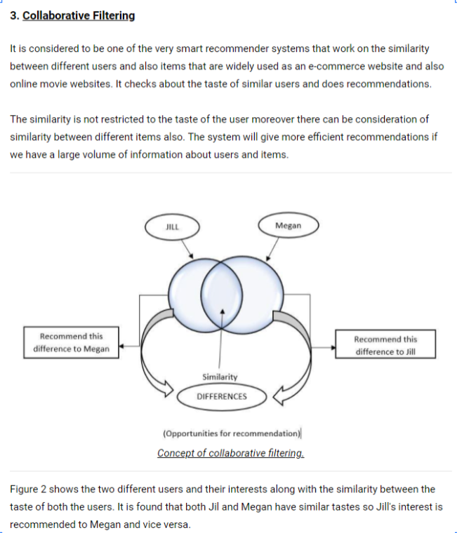
TYPES OF RECOMMENDATION SYSTEM
COLLABORATIVE FILTERING
CONTENT-BASED RECOMMENDATION SYSTEM

Slide 42
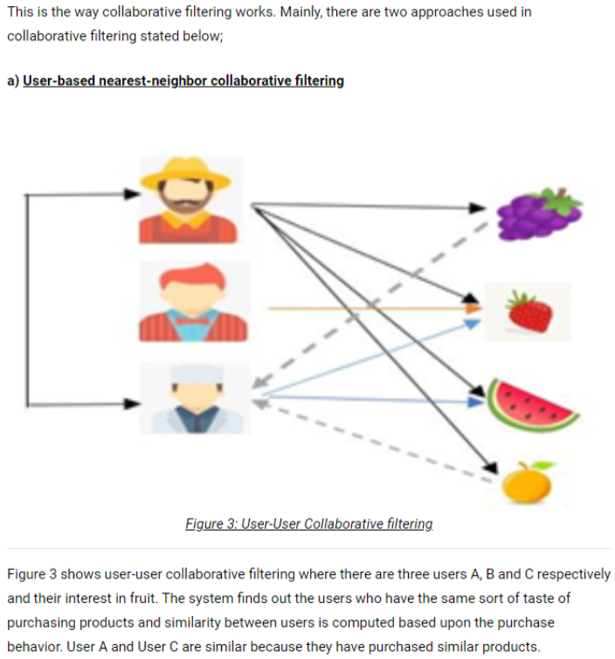

Slide 43
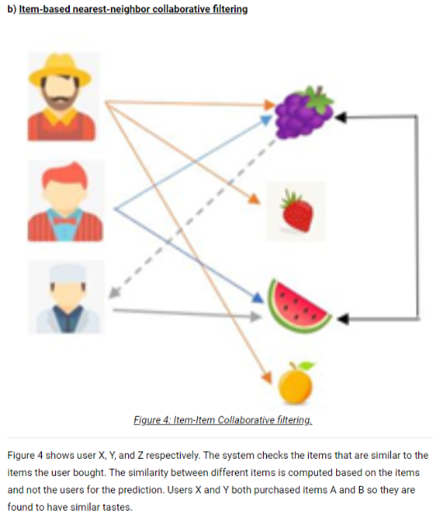

Slide 44
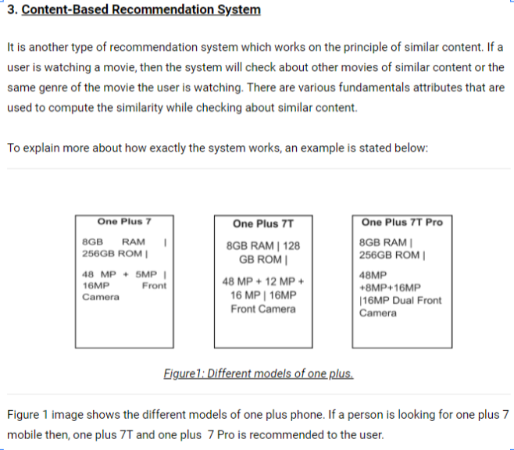

Slide 45
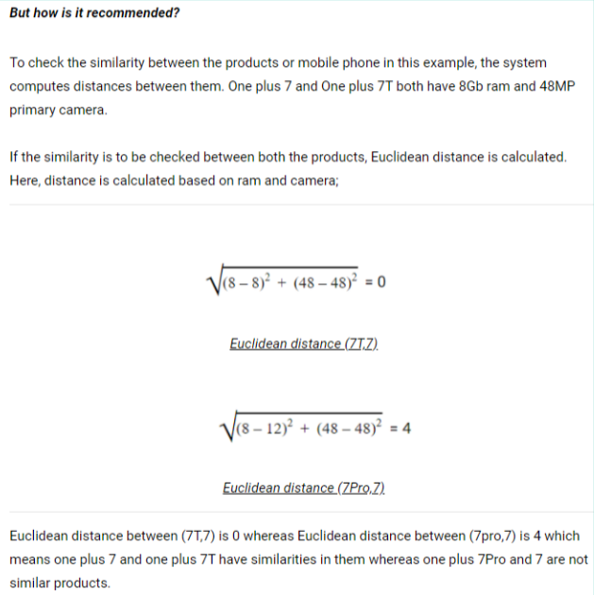
BUT HOW IS IT RECOMMENDED?

Slide 46
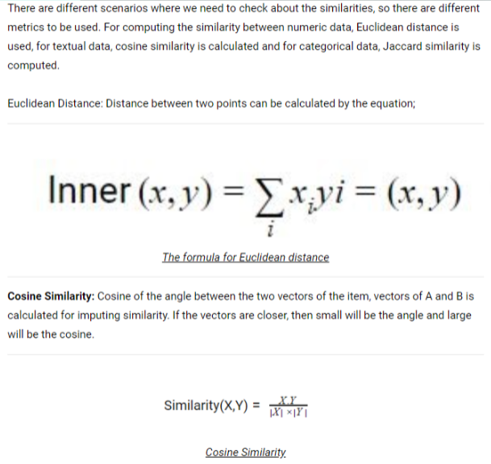
DIFFERENT SCENARIOS

Slide 47
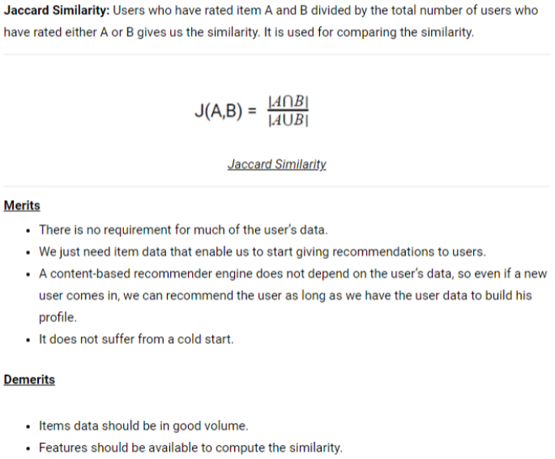

Slide 48
THANK YOU..

